Slide 1
Java Multithreading / Concurrency

Slide 2
Thread
Thread: single sequential flow of control within a program
Single-threaded program can handle one task at any time.
Multitasking allows single processor to run several concurrent threads.
Most modern operating systems support multitasking.

Slide 3
Advantages of Multithreading
Reactive systems – constantly monitoring
More responsive to user input – GUI application can interrupt a time-consuming task
Server can handle multiple clients simultaneously
Can take advantage of parallel processing

Slide 4
Different processes do not share memory space.
A thread can execute concurrently with other threads within a single process.
All threads managed by the JVM share memory space and can communicate with each other.

Slide 5
Threads Concept
Multiple threads on multiple CPUs
Multiple threads sharing a single CPU

Slide 6
Threads in Java
Creating threads in Java:
Extend java.lang.Thread class
OR
Implement java.lang.Runnable interface

Slide 7
Threads in Java
Creating threads in Java:
Extend java.lang.Thread class
run() method must be overridden (similar to main method of sequential program)
run() is called when execution of the thread begins
A thread terminates when run() returns
start() method invokes run()
Calling run() does not create a new thread
Implement java.lang.Runnable interface

Slide 8
Threads in Java
Creating threads in Java:
Extend java.lang.Thread class
Implement java.lang.Runnable interface
If already inheriting another class (i.e., JApplet)
Single method: public void run()
Thread class implements Runnable.

Slide 9
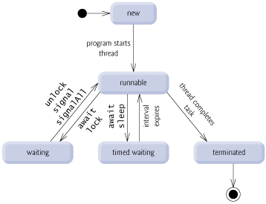
Thread States

Slide 10
Thread termination
A thread becomes Not Runnable when one of these events occurs:
Its sleep method is invoked.
The thread calls the wait method to wait for a specific condition to be satisifed.
The thread is blocking on I/O.

Slide 11
Creating Tasks and Threads

Slide 12
Example: Using the Runnable Interface to Create and Launch Threads
Objective: Create and run three threads:
The first thread prints the letter a 100 times.
The second thread prints the letter b 100 times.
The third thread prints the integers 1 through 100.

Slide 13
The Thread Class

Slide 14
The Static yield() Method
You can use the yield() method to temporarily release time for other threads. For example, suppose you modify the code in Lines 53-57 in TaskThreadDemo.java as follows:
public void run() {
for (int i = 1; i <= lastNum; i++) {
System.out.print(" " + i);
Thread.yield();
}
}
Every time a number is printed, the print100 thread is yielded. So, the numbers are printed after the characters.

Slide 15
The Static sleep(milliseconds) Method
The sleep(long mills) method puts the thread to sleep for the specified time in milliseconds. For example, suppose you modify the code in Lines 53-57 in TaskThreadDemo.java as follows:
public void run() {
for (int i = 1; i <= lastNum; i++) {
System.out.print(" " + i);
try {
if (i >= 50) Thread.sleep(1);
}
catch (InterruptedException ex) {
}
}
}
Every time a number (>= 50) is printed, the print100 thread is put to sleep for 1 millisecond.

Slide 16
The join() Method
You can use the join() method to force one thread to wait for another thread to finish. For example, suppose you modify the code in Lines 53-57 in TaskThreadDemo.java as follows:
The numbers after 50 are printed after thread printA is finished.

Slide 17
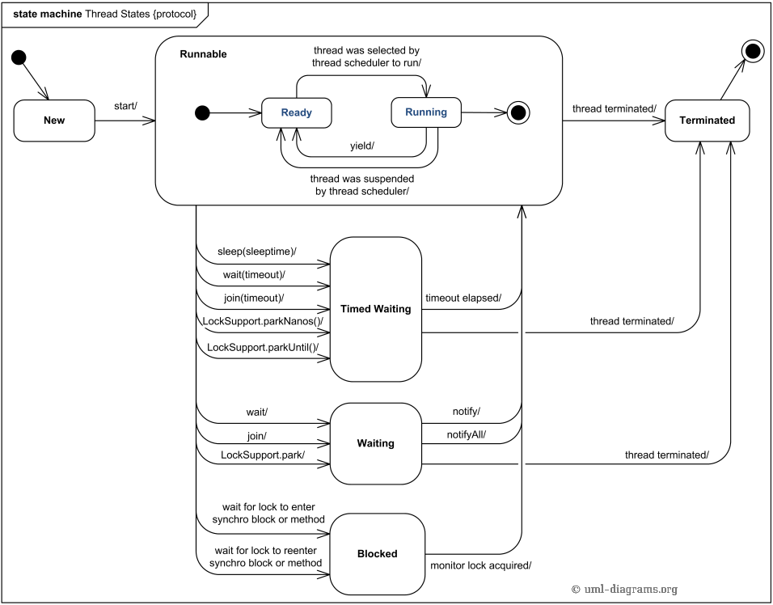
Thread States

Slide 18
Thread methods
isAlive()
method used to find out the state of a thread.
returns true: thread is in the Ready, Blocked, or Running state
returns false: thread is new and has not started or if it is finished.
interrupt()
f a thread is currently in the Ready or Running state, its interrupted flag is set; if a thread is currently blocked, it is awakened and enters the Ready state, and an java.io.InterruptedException is thrown.
The isInterrupt() method tests whether the thread is interrupted.

Slide 19
The deprecated stop(), suspend(), and resume() Methods
NOTE: The Thread class also contains the stop(), suspend(), and resume() methods. As of Java 2, these methods are deprecated (or outdated) because they are known to be inherently unsafe. You should assign null to a Thread variable to indicate that it is stopped rather than use the stop() method.

Slide 20
Thread Priority
Each thread is assigned a default priority of Thread.NORM_PRIORITY (constant of 5). You can reset the priority using setPriority(int priority).
Some constants for priorities include Thread.MIN_PRIORITY Thread.MAX_PRIORITY Thread.NORM_PRIORITY
By default, a thread has the priority level of the thread that created it.

Slide 21
Thread Scheduling
An operating system’s thread scheduler determines which thread runs next.
Most operating systems use timeslicing for threads of equal priority.
Preemptive scheduling: when a thread of higher priority enters the running state, it preempts the current thread.
Starvation: Higher-priority threads can postpone (possible forever) the execution of lower-priority threads.

Slide 22
Thread Pools
Starting a new thread for each task could limit throughput and cause poor performance.
A thread pool is ideal to manage the number of tasks executing concurrently.
Executor interface for executing Runnable objects in a thread pool
ExecutorService is a subinterface of Executor.

Slide 23
Creating Executors
To create an Executor object, use the static methods in the Executors class.

Slide 24
Thread Synchronization
A shared resource may be corrupted if it is accessed simultaneously by multiple threads.
Example: two unsynchronized threads accessing the same bank account may cause conflict.

Slide 25
Example: Showing Resource Conflict
Objective: Write a program that demonstrates the problem of resource conflict. Suppose that you create and launch one hundred threads, each of which adds a penny to an account. Assume that the account is initially empty.

Slide 26
Race Condition
What, then, caused the error in the example? Here is a possible scenario:
Effect: Task 1 did nothing (in Step 4 Task 2 overrides the result)
Problem: Task 1 and Task 2 are accessing a common resource in a way that causes conflict.
Known as a race condition in multithreaded programs.
A thread-safe class does not cause a race condition in the presence of multiple threads.
The Account class is not thread-safe.

Slide 27
synchronized
Problem: race conditions
Solution: give exclusive access to one thread at a time to code that manipulates a shared object.
Synchronization keeps other threads waiting until the object is available.
The synchronized keyword synchronizes the method so that only one thread can access the method at a time.
The critical region in the Listing 29.7 is the entire deposit method.
One way to correct the problem in Listing 29.7: make Account thread-safe by adding the synchronized keyword in deposit:
public synchronized void deposit(double amount)

Slide 28
Synchronizing Instance Methods and Static Methods
A synchronized method acquires a lock before it executes.
Instance method: the lock is on the object for which it was invoked.
Static method: the lock is on the class.
If one thread invokes a synchronized instance method (respectively, static method) on an object, the lock of that object (respectively, class) is acquired, then the method is executed, and finally the lock is released.
Another thread invoking the same method of that object (respectively, class) is blocked until the lock is released.

Slide 29
Synchronizing Instance Methods and Static Methods
With the deposit method synchronized, the preceding scenario cannot happen. If Task 2 starts to enter the method, and Task 1 is already in the method, Task 2 is blocked until Task 1 finishes the method.

Slide 30
Synchronizing Statements
Invoking a synchronized instance method of an object acquires a lock on the object.
Invoking a synchronized static method of a class acquires a lock on the class.
A synchronized block can be used to acquire a lock on any object, not just this object, when executing a block of code.
synchronized (expr) {
statements;
}
expr must evaluate to an object reference.
If the object is already locked by another thread, the thread is blocked until the lock is released.
When a lock is obtained on the object, the statements in the synchronized block are executed, and then the lock is released.

Slide 31
Synchronizing Statements vs. Methods
Any synchronized instance method can be converted into a synchronized statement. Suppose that the following is a synchronized instance method:
public synchronized void xMethod() {
// method body
}
This method is equivalent to
public void xMethod() {
synchronized (this) {
// method body
}
}

Slide 32
Synchronization Using Locks
A synchronized instance method implicitly acquires a lock on the instance before it executes the method.
You can use locks explicitly to obtain more control for coordinating threads.
A lock is an instance of the Lock interface, which declares the methods for acquiring and releasing locks.
newCondition() method creates Condition objects, which can be used for thread communication.

Slide 33
Fairness Policy
ReentrantLock:concrete implementation of Lock for creating mutually exclusive locks.
Create a lock with the specified fairness policy.
True fairness policies guarantee the longest-wait thread to obtain the lock first.
False fairness policies grant a lock to a waiting thread without any access order.
Programs using fair locks accessed by many threads may have poor overall performance than those using the default setting, but have smaller variances in times to obtain locks and guarantee lack of starvation.

Slide 34
Cooperation Among Threads
Conditions can be used for communication among threads.
A thread can specify what to do under a certain condition.
newCondition() method of Lock object.
Condition methods:
await() current thread waits until the condition is signaled
signal() wakes up a waiting thread
signalAll() wakes all waiting threads

Slide 35
Cooperation Among Threads
Lock with a condition to synchronize operations: newDeposit
If the balance is less than the amount to be withdrawn, the withdraw task will wait for the newDeposit condition.
When the deposit task adds money to the account, the task signals the waiting withdraw task to try again.
Interaction between the two tasks:

Slide 36
Example: Thread Cooperation
Write a program that demonstrates thread cooperation. Suppose that you create and launch two threads, one deposits to an account, and the other withdraws from the same account. The second thread has to wait if the amount to be withdrawn is more than the current balance in the account. Whenever new fund is deposited to the account, the first thread notifies the second thread to resume. If the amount is still not enough for a withdrawal, the second thread has to continue to wait for more fund in the account. Assume the initial balance is 0 and the amount to deposit and to withdraw is randomly generated.

Slide 37
Monitors
Locks and conditions are more powerful and flexible than the built-in monitor.
A monitor is an object with mutual exclusion and synchronization capabilities.
Only one thread can execute a method at a time in the monitor.
A thread enters the monitor by acquiring a lock (synchronized keyword on method / block) on the monitor and exits by releasing the lock.
A thread can wait in a monitor if the condition is not right for it to continue executing in the monitor.
Any object can be a monitor. An object becomes a monitor once a thread locks it.

Slide 38
wait(), notify(), and notifyAll()
Use the wait(), notify(), and notifyAll() methods to facilitate communication among threads.
The wait(), notify(), and notifyAll() methods must be called in a synchronized method or a synchronized block on the calling object of these methods. Otherwise, an IllegalMonitorStateException would occur.
The wait() method lets the thread wait until some condition occurs. When it occurs, you can use the notify() or notifyAll() methods to notify the waiting threads to resume normal execution. The notifyAll() method wakes up all waiting threads, while notify() picks up only one thread from a waiting queue.

Slide 39
Example: Using Monitor
The wait(), notify(), and notifyAll() methods must be called in a synchronized method or a synchronized block on the receiving object of these methods. Otherwise, an IllegalMonitorStateException will occur.
When wait() is invoked, it pauses the thread and simultaneously releases the lock on the object. When the thread is restarted after being notified, the lock is automatically reacquired.
The wait(), notify(), and notifyAll() methods on an object are analogous to the await(), signal(), and signalAll() methods on a condition.

Slide 40
Case Study: Producer/Consumer
Consider the classic Consumer/Producer example. Suppose you use a buffer to store integers. The buffer size is limited. The buffer provides the method write(int) to add an int value to the buffer and the method read() to read and delete an int value from the buffer. To synchronize the operations, use a lock with two conditions: notEmpty (i.e., buffer is not empty) and notFull (i.e., buffer is not full). When a task adds an int to the buffer, if the buffer is full, the task will wait for the notFull condition. When a task deletes an int from the buffer, if the buffer is empty, the task will wait for the notEmpty condition. The interaction between the two tasks is shown in Figure 29.19.

Slide 41
Semaphores
Semaphores can be used to restrict the number of threads that access a shared resource. Before accessing the resource, a thread must acquire a permit from the semaphore. After finishing with the resource, the thread must return the permit back to the semaphore.

Slide 42
Creating Semaphores
To create a semaphore, you have to specify the number of permits with an optional fairness policy, as shown in Figure 29.29. A task acquires a permit by invoking the semaphore’s acquire() method and releases the permit by invoking the semaphore’s release() method. Once a permit is acquired, the total number of available permits in a semaphore is reduced by 1. Once a permit is released, the total number of available permits in a semaphore is increased by 1.

Slide 43
Deadlock
Sometimes two or more threads need to acquire the locks on several shared objects.
This could cause deadlock, in which each thread has the lock on one of the objects and is waiting for the lock on the other object.
In the figure below, the two threads wait for each other to release the in order to get a lock, and neither can continue to run.

